Slide 1
Tutorial 1

Slide 2
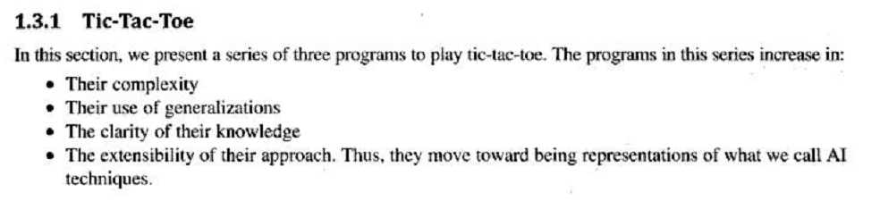

Slide 3
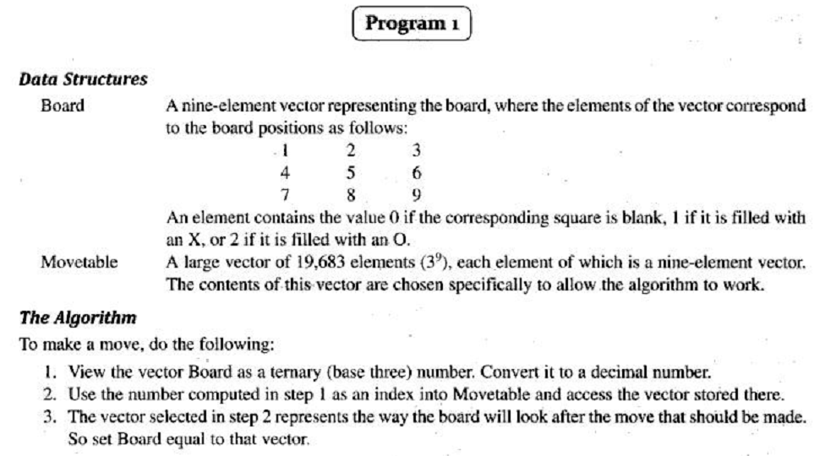

Slide 4
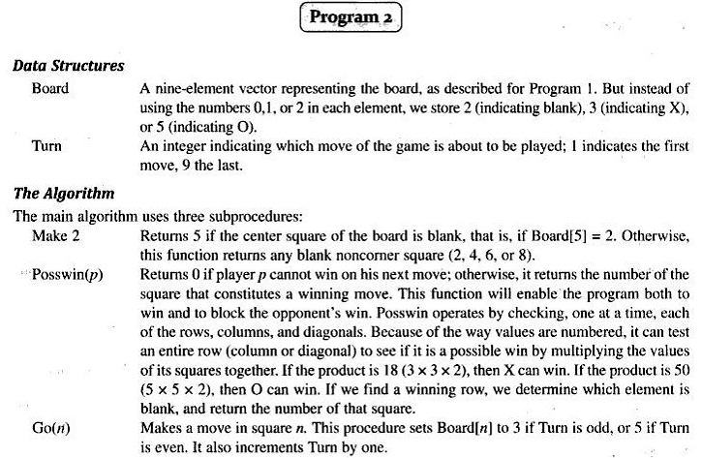

Slide 5
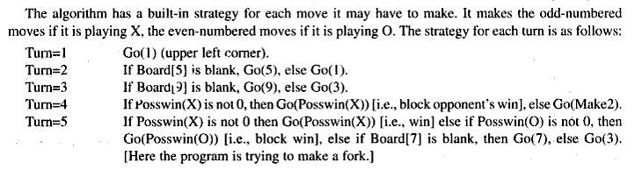
Turn=6 If Posswin(o) is not 0 then Go(Posswin(o)), else If Posswin(x) is not 0 then Go(Posswin(X)), else Go(make 2).
Turn=7 If Posswin(x) is not 0 then Go(Posswin(x)), else If Posswin(o) is not 0 then Go(Posswin(o)), else Go anywhere that is blank
Turn=8 If Posswin(o) is not 0 then Go(Posswin(o)), else If Posswin(x) is not 0 then Go(Posswin(x), else Go anywhere that is blank
Turn=9 Same as 7.

Slide 6
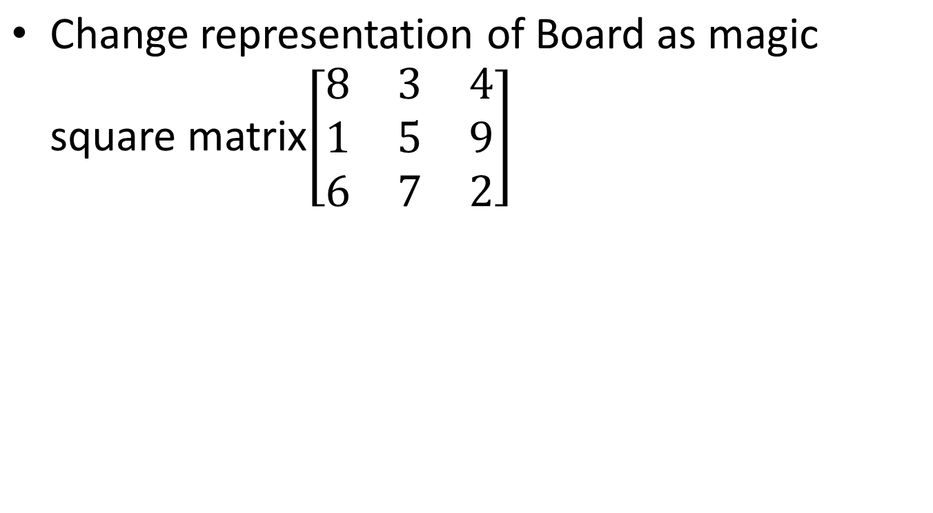
Program 2’

Slide 7
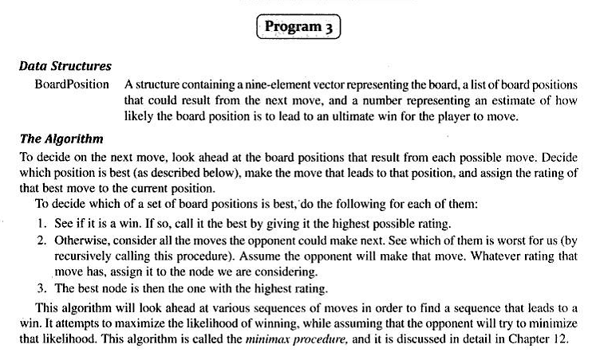

Slide 8
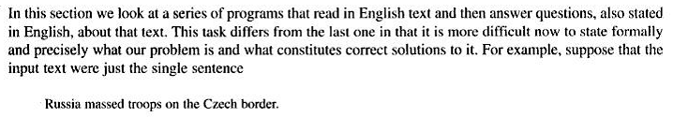
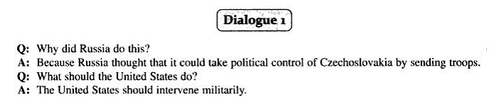
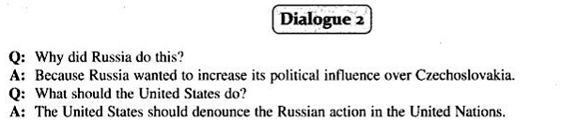

Slide 9
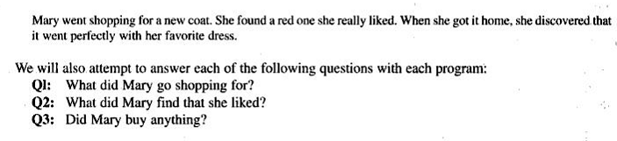

Slide 10
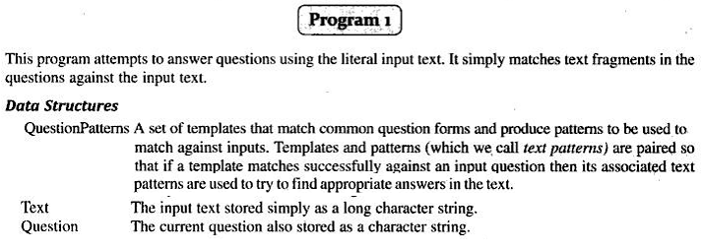
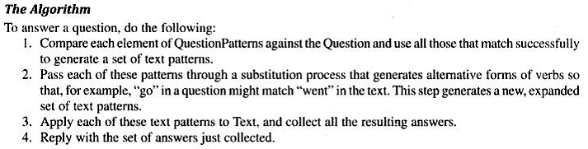

Slide 11
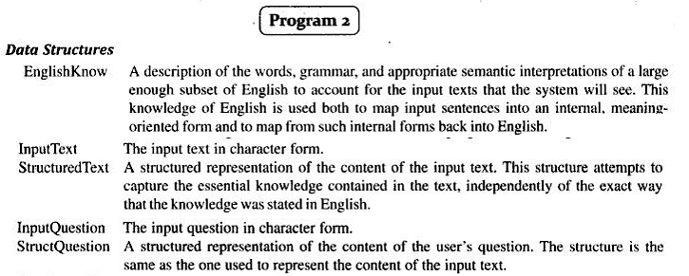
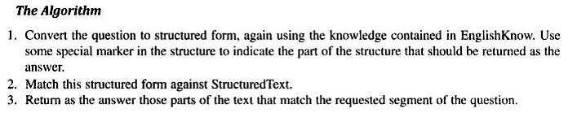

Slide 12

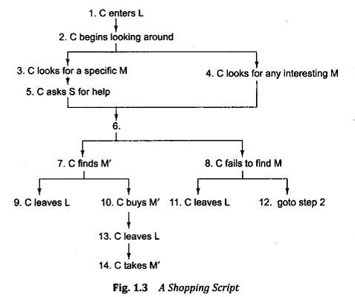

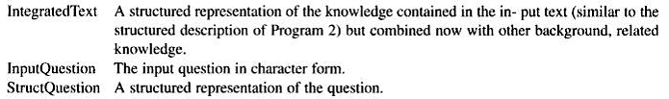

Slide 13
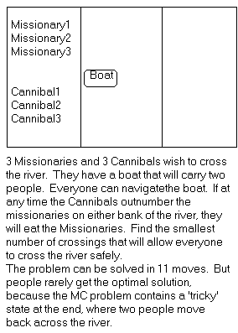
Missionaries and Cannibals
There are 3 missionaries, 3 cannibals, and 1 boat that can carry up to two people on one side of a river.
Goal: Move all the missionaries and cannibals across the river.
Constraint: Missionaries can never be outnumbered by cannibals on either side of river, or else the missionaries are killed.
State: configuration of missionaries and cannibals and boat on each side of river.
Operators: Move boat containing some set of occupants across the river (in either direction) to the other side.

Slide 14
Missionaries and Cannibals Solution
Near side Far side
0 I nitial setup: MMMCCC B -
1 Two cannibals cross over: MMMC B CC
2 One comes back: MMMCC B C
3 Two cannibals go over again: MMM B CCC
4 One comes back: MMMC B CC
5 Two missionaries cross: MC B MMCC
6 A missionary & cannibal return: MMCC B MC
7 Two missionaries cross again: CC B MMMC
8 A cannibal returns: CCC B MMM
9 Two cannibals cross: C B MMMCC
10 One returns: CC B MMMC
11 And brings over the third: - B MMMCCC

Slide 15
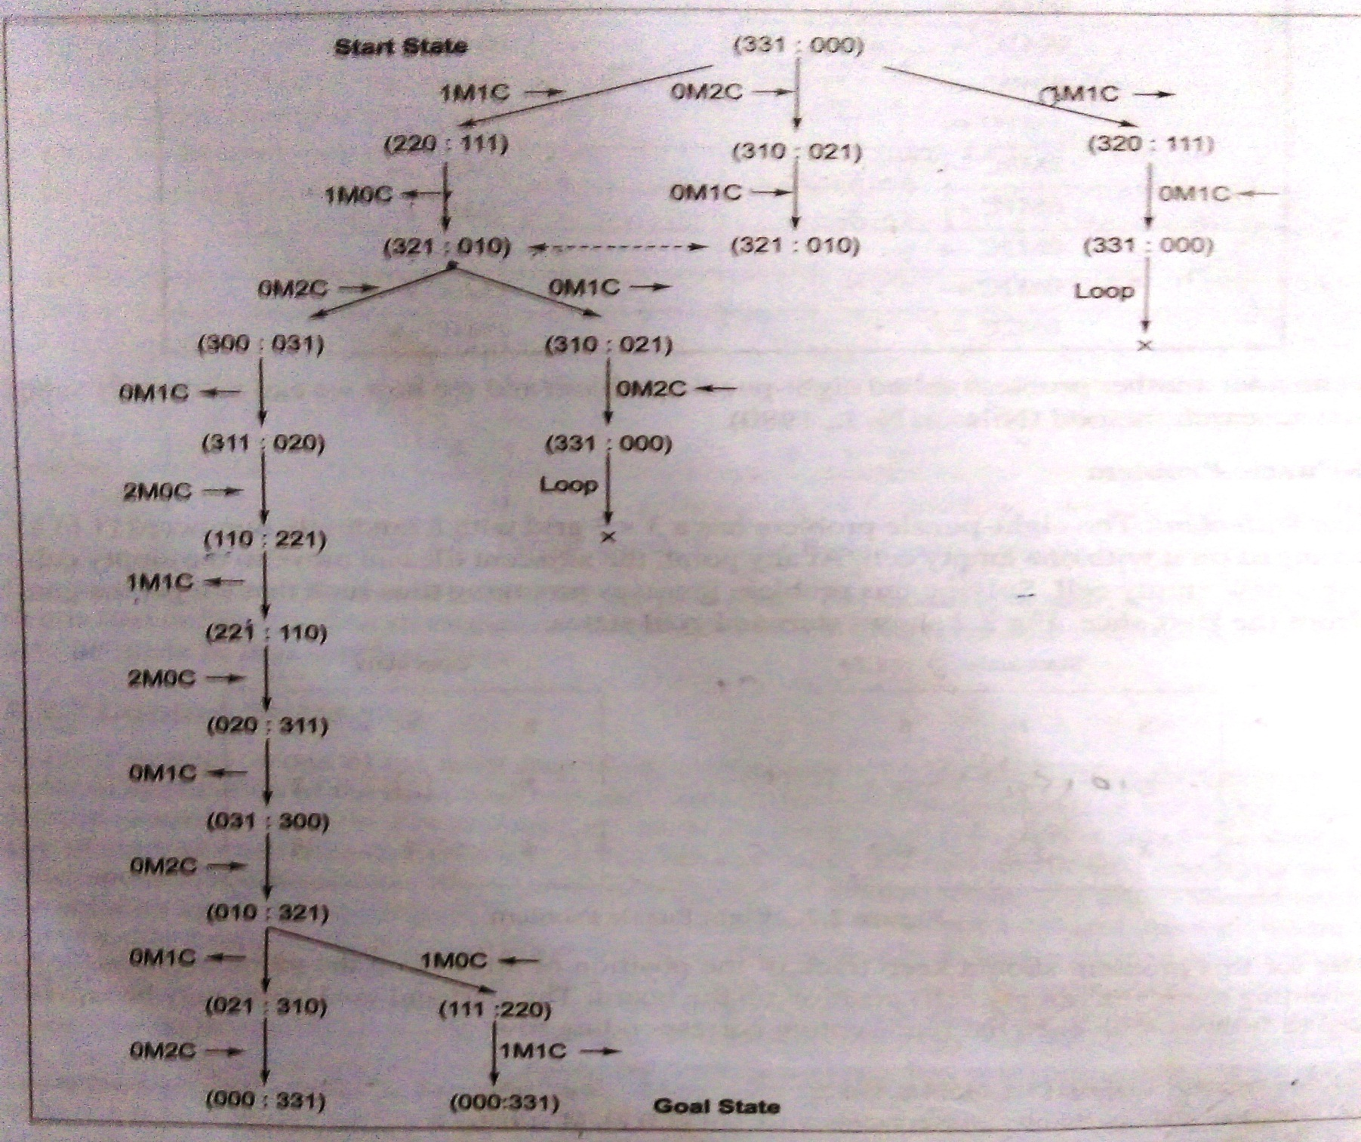

Slide 16
State space Representation of Farmer, wolf, goat and cabbage problem:
A farmer with wolf, goat & cabbage come to the edge of river. They want to cross the river. There is a boat at river edge but only the farmer can row, the boat can carry two things at a time. If the wolf is ever left alone with the goat, the wolf will eat the goat, similarly if the goat is left alone with cabbage, the goat will eat cabbage. Schedule the things so that all four characters arrive safely on the other side of the river.
Man →M
Wolf →W
Goat →G
Cabbage →C
.
Seq. of crossing the river so that all four character arrive safely is
First Man cross the river with goat.
Man come back.
Man either takes cabbage or wolf with him to another side.
Man comes back with goat to first side.
Man taken wolf (or cabbage) with him to another side.
Man comes back.
Man takes goat with him to another back

Slide 17
